Slide 1

Penalty Kick Game - from Tian Ji’s Horse Racing to Football Penalty
Haowen ji
Econ 206

Slide 2

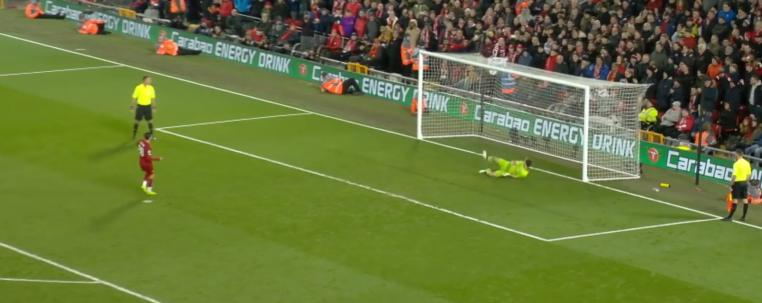
Background & Motivation
Key Terminology: Penalty shoot-out is a tie-breaking method in football, to determine the winner of a match that remains undecided after regular play. It involves a series of one-on-one penalty kicks between players and the goalkeeper. The objective is for the attacking player to successfully score a goal by shooting the ball into the net while the goalkeeper tries to prevent it.
The existing research on penalty shoot-outs mainly focuses on the single round of the penalty, instead of the order of the kickers.
The horse racing story of Tian Ji inspired me with designing the game based on the order
The Penalty Kick Game explores optimal strategies for weaker teams. By strategically selecting players and considering shooting probabilities, weaker teams can enhance their chances of winning rounds and ultimately the game.
https://www.facebook.com/LiverpoolFC/videos/990428344631981/

Slide 3
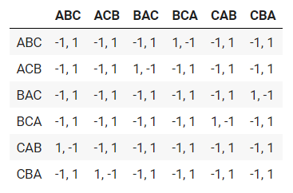
Tian Ji Horse Racing
Tian Ji’s Horse Racing (田忌赛马): Tian Ji and the king of the Qi Kingdom both like horse racing. The king of Qi has better horses, so Tian Ji loses all the time when they use the same level of horses to race. For each round, Tian Ji and the king both choose three horses, and classify them as good, better, and best. The winner is the one who wins at least two rounds.
Sun Bin advised Tian Ji (T) to use the following strategy in horse racing:
T's "good" horse (C) races against K's "best" horse (A).
T's "best" horse (A) races against K's "better" horse (B).
T's "better" horse (B) races against K's "good" horse (C).

Slide 4
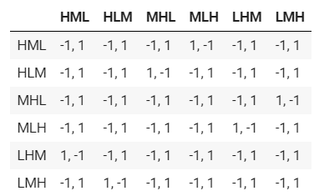
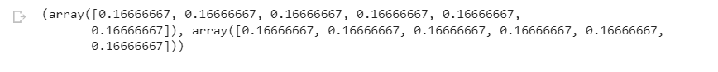
Penalty Kick Game
The Penalty kick game simulates the penalty shoot-out in real football games. This game follows the following rule: two coaches in two different football teams are the two players in this game. One team's player is better than the other team. In each game, two coaches both select three players. The player has different levels, which are low(L), middle(M), and high(H). The game operates under the rule of three rounds, with the victor being the one who first wins two rounds.
Solution:
With Nash Equilibrium, a mixed strategy game is built, which is to choose randomly for both coaches.
If the strategy of the stronger team is known, the weaker team coach can choose to use the same strategy as Tian Ji to win the game.

Slide 5
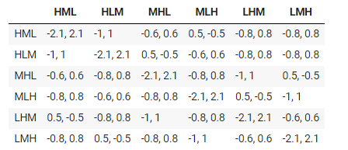
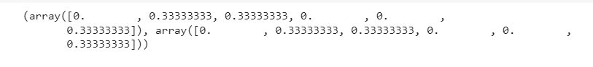
Penalty Kick Game with Probability
However, in real-world scenarios, there is a possibility that the player misses the goal. Based on the situation, the game sets the probability of shooting as follows:
Week team: High-level(80%), Middle-level(60%), Low-Level(40%)
Strong team: High-level(90%), Middle-level(70%), Low-Level(50%)
For example, if both of them choose HML, the stronger team will win all three rounds, so it is 0.9+0.7+0.5 = 2.1
The solution with Nash Equilibrium is to choose randomly from HLM, MHL, and LMH for both coaches.
If the strategy of the stronger team is known, the Strategy of Tian Ji is still the optimal strategy for the weak team.

Slide 6
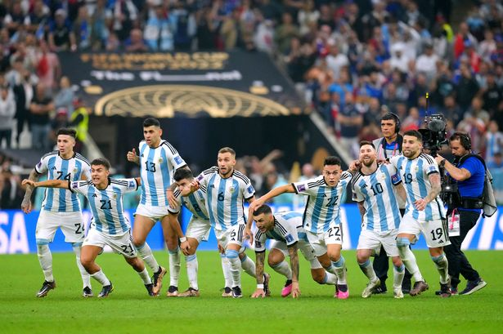
Real-world Cases
The strategy in Argentina is accorded with Tian Ji’s strategy.
In the first round, they used the high player to play against the middle player.
In the second round, they used middle-level players to play against the low player.
4th Round
Randal Kolo Muani goal (FRA 2, ARG 3) (High)
Gonzalo Montiel goal (FRA 2, ARG 4) *** Argentina win World Cup (Middle)
3rd Round
Aurelien Tchouameni wide (FRA 1, ARG 2) (Middle)
Leandro Paredes goal (FRA 1, ARG 3) (Low)
2nd Round
Kingsley Coman saved (FRA 1, ARG 1) (Low)
Paulo Dybala goal (FRA 1, ARG 2) (Middle)
1st Round
Kylian Mbappe goal (FRA 1, ARG 0) (Middle)
Lionel Messi goal (FRA 1, ARG 1) (High)
https://www.chroniclelive.co.uk/news/north-east-news/argentina-wins-world-cup-after-25783464

Slide 7
Acknowledgement
I would like to express my sincere gratitude to Professor Luyao Zhang for providing valuable instructions and for inspiring the idea of combining Tian Ji's Horse Racing and the Penalty Kick Game.
Thanks Yuchen, Cong Rong, Yiwei, and Yiyuan for their advice and inspiration throughout my final project.
Furthermore, I would like to thank everyone in the class for their enthusiasm and contributions. The engaging discussions and shared knowledge have truly made this a stimulating learning experience.

